Slide 1
(Raspberry) PI Day
3/2/24
ORION

Slide 2
Agenda for Today…
Learn about single board computers (SBC)
What can they do? What are they used for? How much do they typically cost? $
Discuss Arduino versus Raspberry Pi? Differences?
Learn about enabling the technologies…
Linux OS,
IoT (Internet-of-things)
Introduction to computer programming…
Making hardware and software talk:
Network protocols: MQTT and HTTP (Web sockets)
Develop Hands on project: You will use the Raspberry Pi 3 to construct a custom IoT Device: Build “Smart” (IoT) light bulb from scratch
Ingredients?
A Raspberry PI 3B, and a few electronic components, and an ordinary desktop
You build the software to make it work.

Slide 3



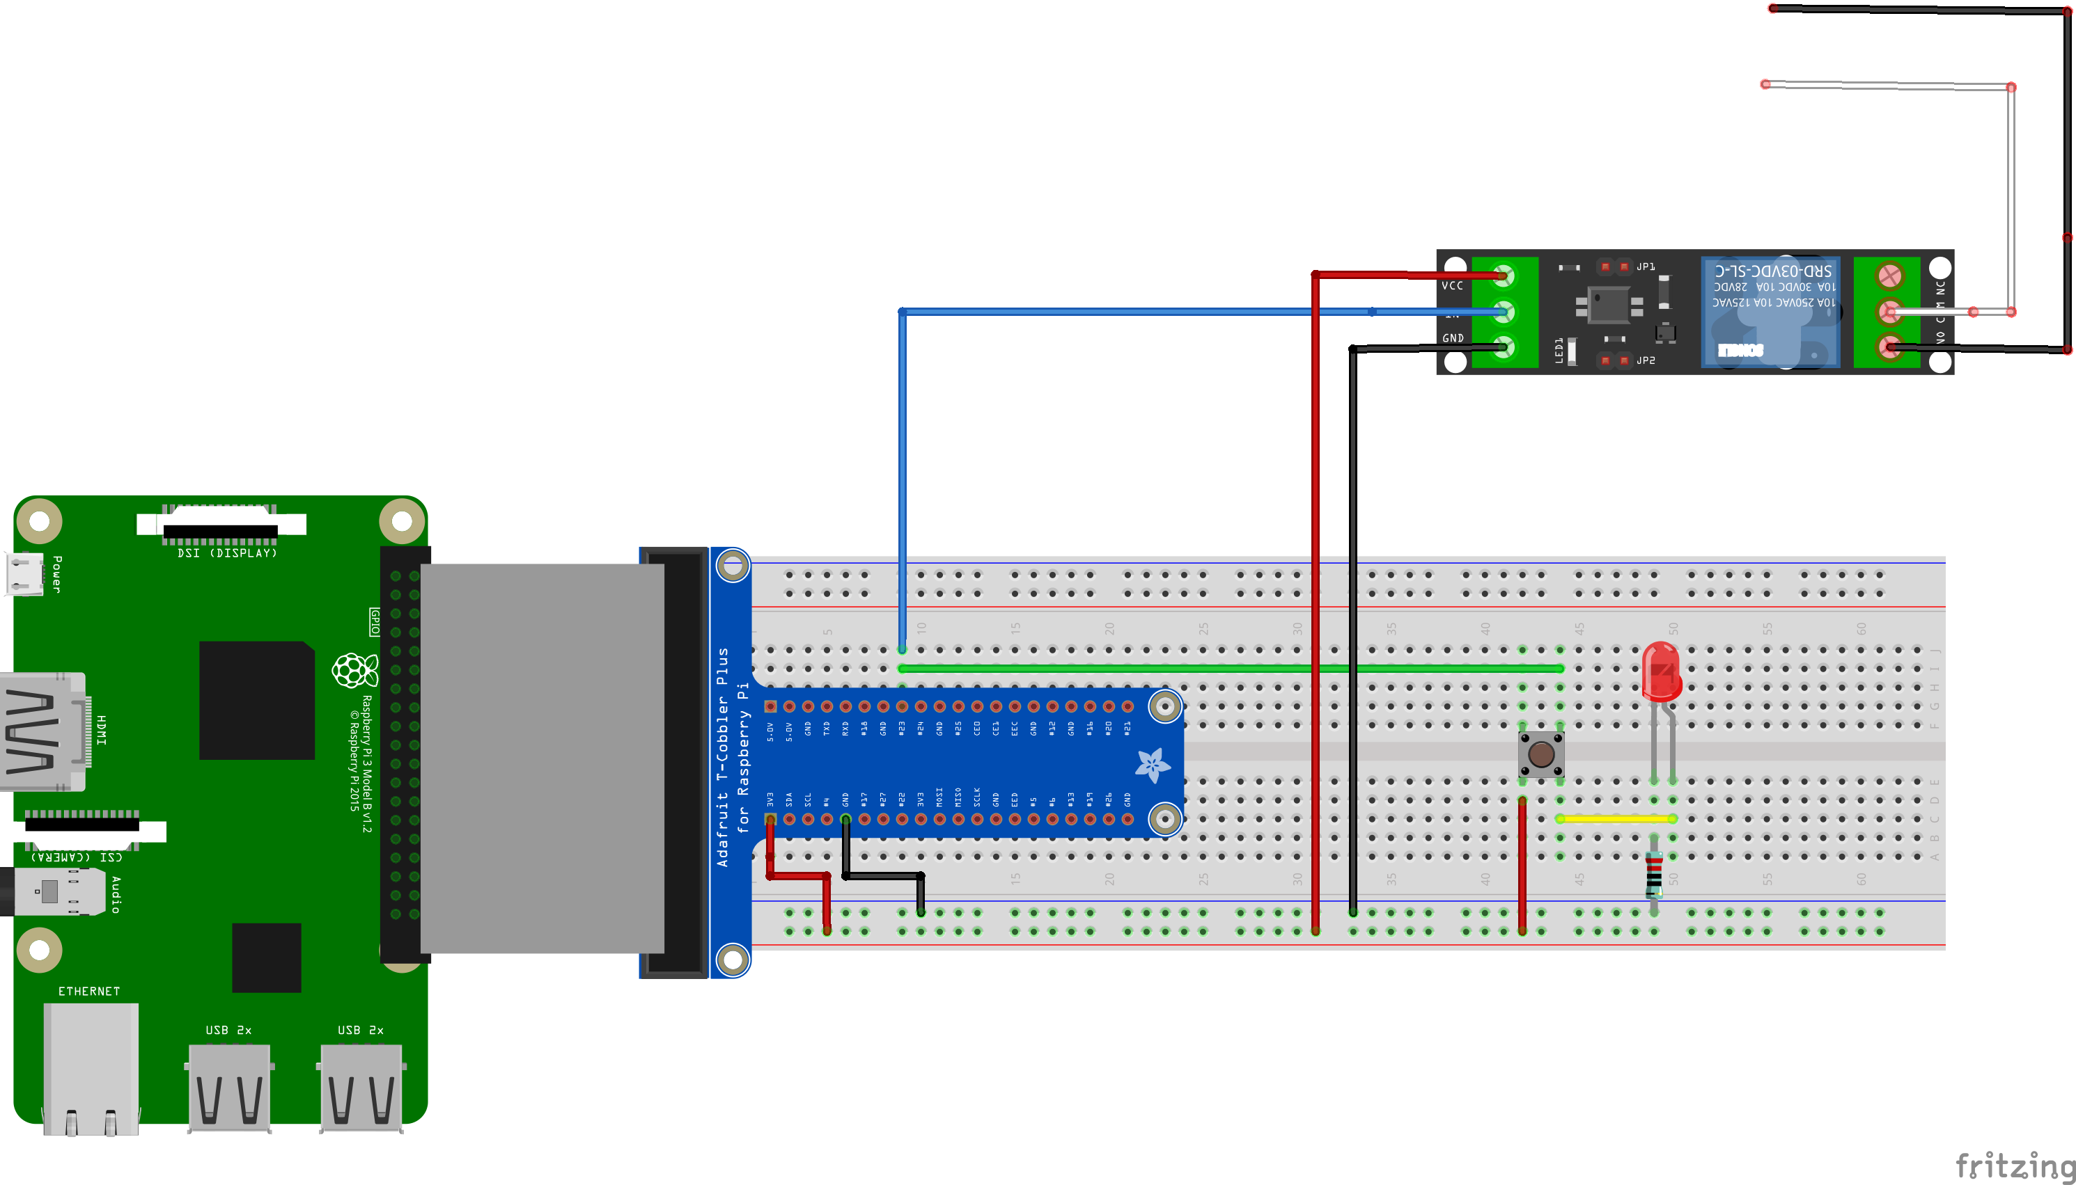
The Prototype
Bulb/
MQTT Broker
MQTT / Web sockets
Web page:
html 5 / JavaScript
Python
Backend
Bulb/message

Slide 4
Project: Develop an IoT “Smart” Light bulb from scratch
Develop the hardware:
Design and implement an electronic circuit required to remotely control the operation of an ordinary table lamp
Develop the software
Design and implement a web (front-end) user interface to drive a light bulb
Design and implement electronic circuit (the IoT hardware) to control the lamp
Use MQTT protocol to make the software and hardware communicate.

Slide 5
Links
https://www.raspberrypi.com/for-home/
https://www.raspberrypi.com/for-in
https://www.youtube.com/watch?v=eZ74x6dVYes
https://www.youtube.com/watch?v=p40OetppIDg
https://randomnerdtutorials.com/getting-started-with-raspberry-pi/
https://socialcompare.com/en/comparison/raspberrypi-models-comparison
Let's Learn .NET - IoT (Internet of Things) (youtube.com) 3:22 and 14:30

Slide 6
Module 1: Provisioning the Raspberry Pi for Use

Slide 7
Install and Configure the Operating System (OS) and Services
Download and Install Raspberry Pi OS using Raspberry Pi Imager
https://www.raspberrypi.com/software/
Insert micro-SD card into USB card reader and run the imager tool. See screen shots below

Slide 8
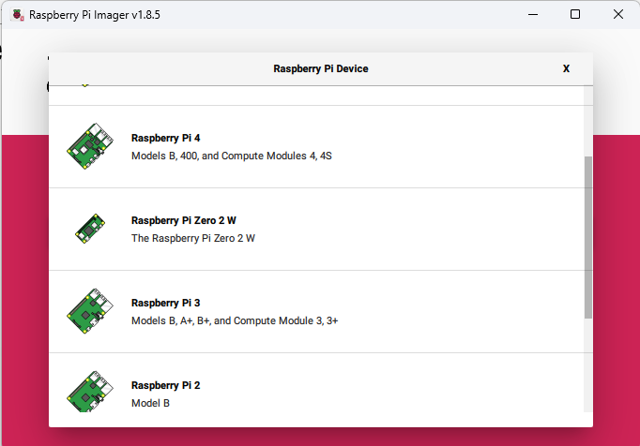
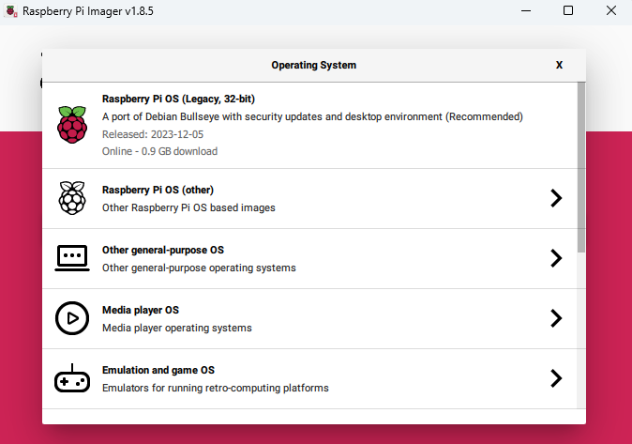
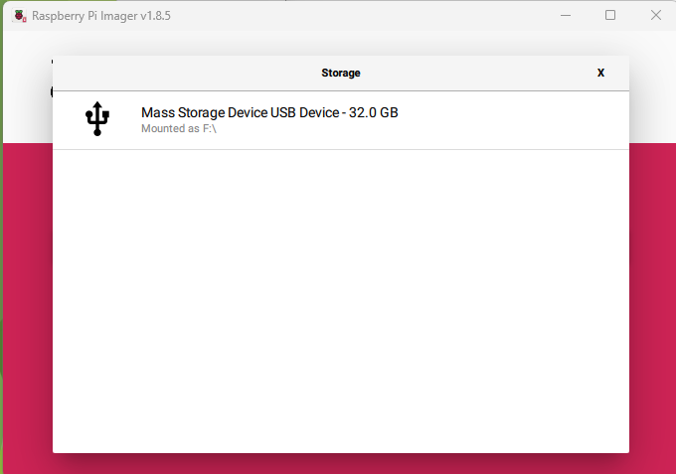
Write the Operating System (OS) Image to the SD card
1. Raspberry Pi device: select your version (Pi 3)
2. Choose OS: Select Pi OS (32 bit) with desktop env.
3. Storage location: Select the micro- SD card from USB reader

Slide 9

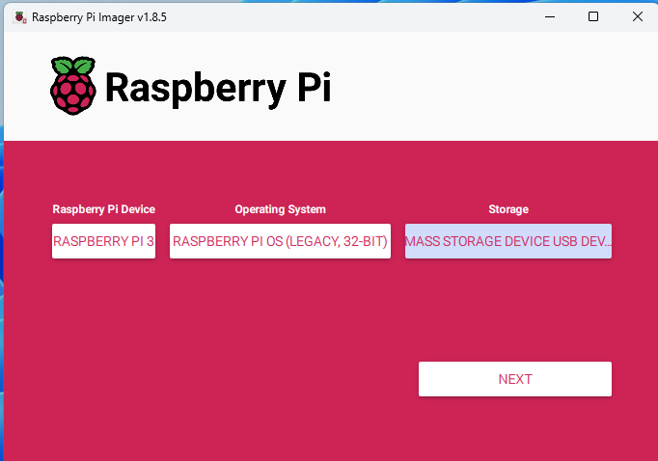
Before you proceed, Make sure….
1. Raspberry Pi 3 is selected
2. 32-bit Legacy OS w/ desktop environment
3. Make sure the micro-SD card is selected as the storage
* Only when 1,2, and 3 are verified, click “next”

Slide 10
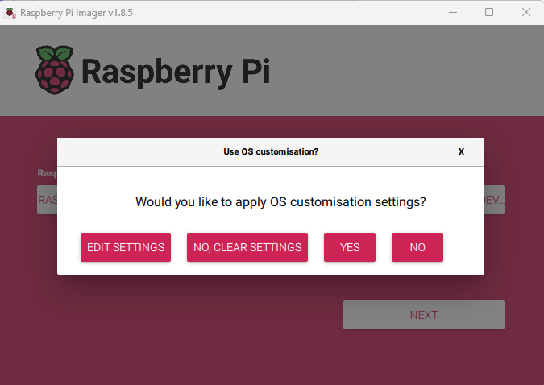
Customize the Settings:
Click “Edit Settings”

Slide 11
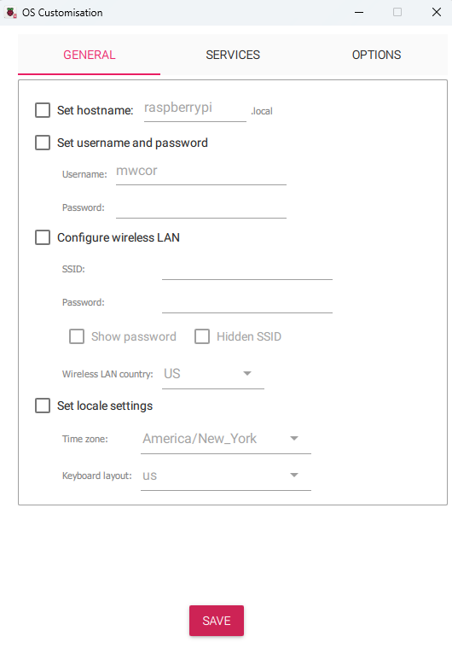
Important! Perform the next steps with the mentor
Follow the instructions as specified, or your Raspberry Pi will not be configured properly for the “smart’ bulb project
Proceed to the next slide to begin

Slide 12
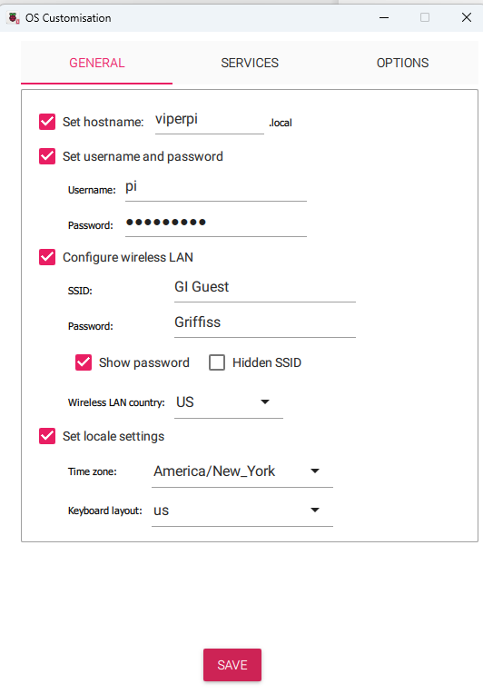
These settings must be as specified, or your Pi will not be properly configured for the project
Specify the hostname. Use your Team name with “pi” appended. For example, Team “Viper”, would use hostname “viperpi” as shown
Set the username to “pi” and the
Password to “team chooses” (don’t share)
Configure the WIFI settings to use the Griffiss institute Guest network.
Select the country to ‘US’ and set the locale settings as illustrated
Click “Save”

Slide 13
Customize the Settings:
Click “Edit Settings”

Slide 14
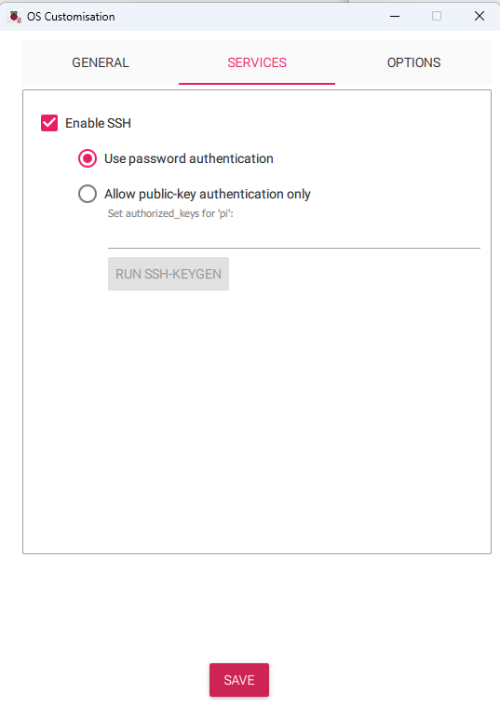
Enable Secure Shell
1. Click “Services” Tab
2. Choose password authentication
3. Save settings

Slide 15
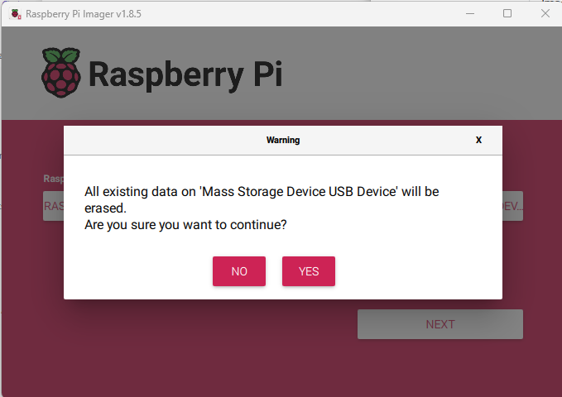
Customize the Settings:
1. Click “Yes”
2. Click “Yes” to write the operating system image

Slide 16
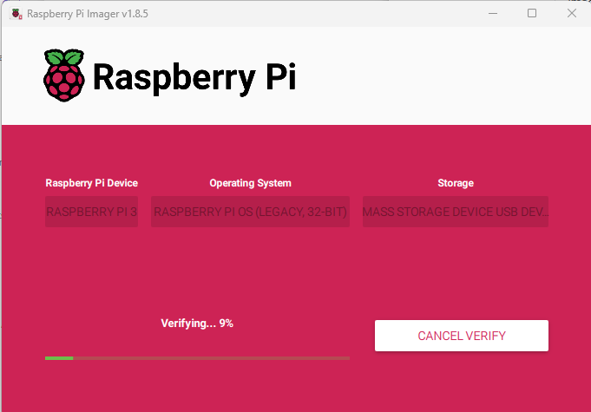
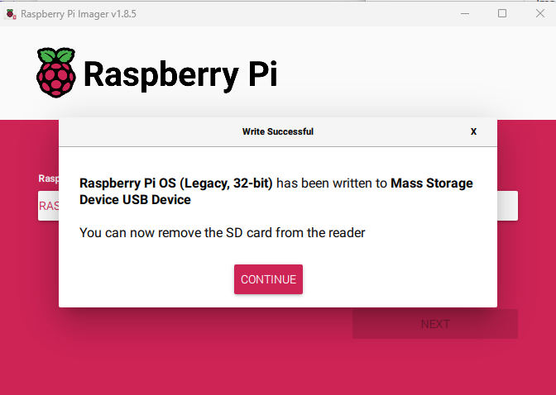
Wait for the OS image to be written to SD-card

Slide 17
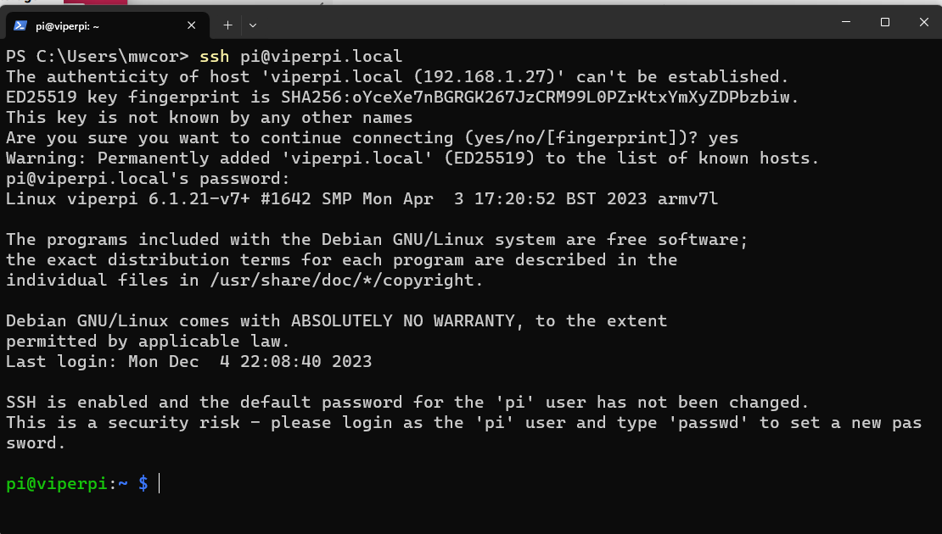
Start an SSH session with the Raspberry Pi
Open a new terminal window
Type command: pi@teamnamepi.local
Replace “teamname” with name of your Team
Example: ssh pi@viperpi.local
Type command: yes
Congratulations. You have a new (remote) connection the Raspberry Pi

Slide 18
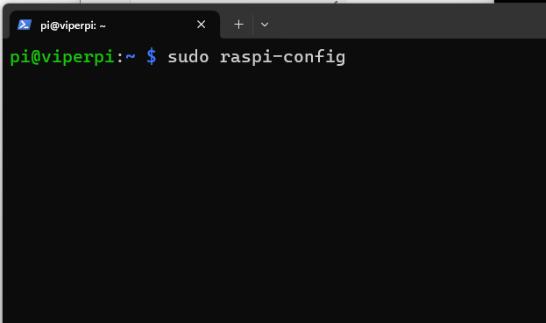
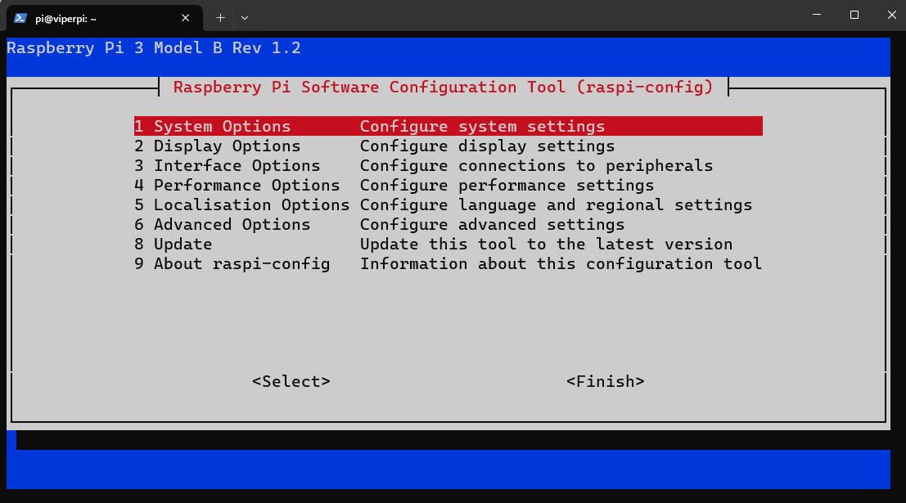
Run the Raspberry Pi configuration tool to configure the services
Type command: sudo raspi-config

Slide 19
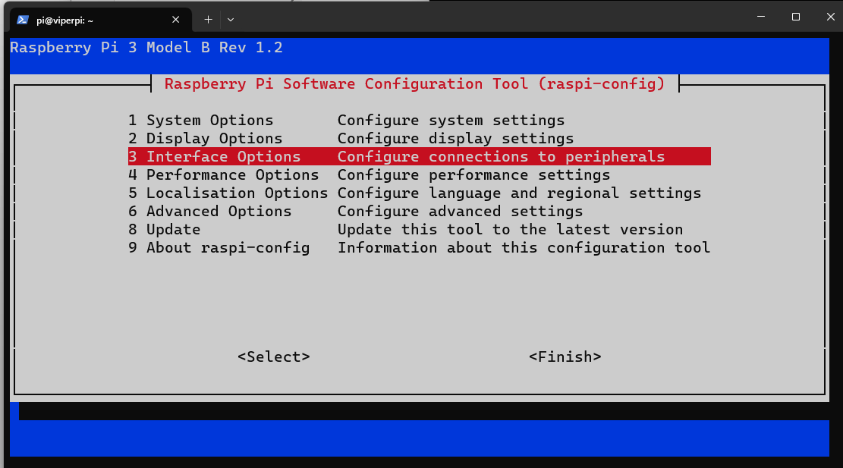
Select Configure the Interfaces:
Select menu item 3:

Slide 20
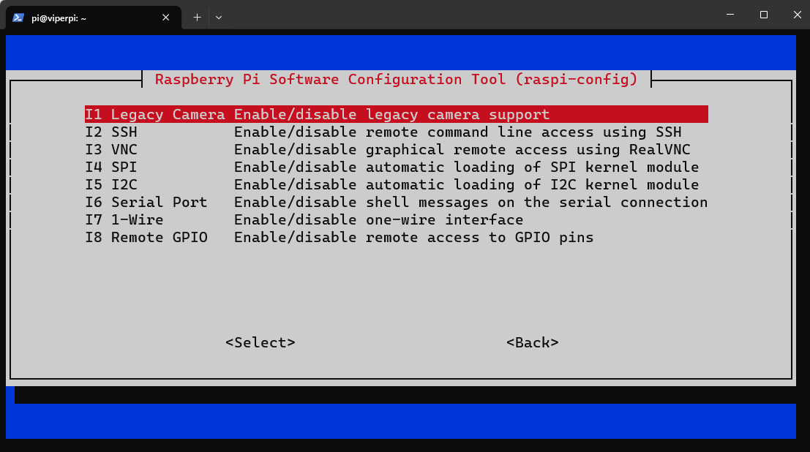
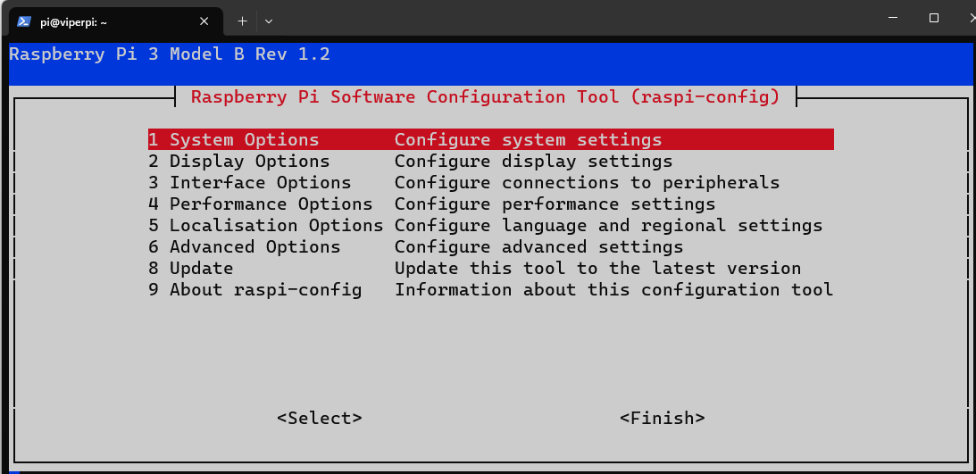
Enable SSH, VNC, and I2C
SSH is already enabled
Enable both VNC and I2C
I2C (Inter-Integrated Circuit) is widely used a serial bus protocol for establish serial communication integrated circuits (ICs)
Select Finish to exit

Slide 21
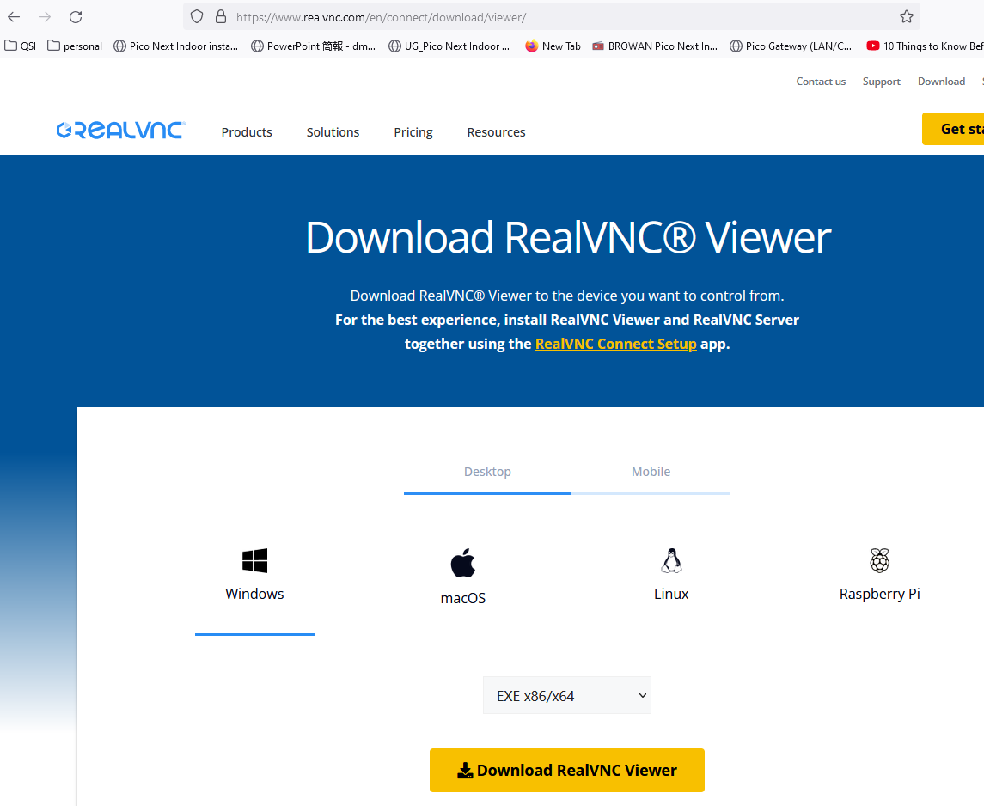
Setup VNC viewer laptop PC
VNC stands for Virtual Network Computing. It is a cross-platform screen sharing system that was created to remotely control/view another computer
Download the VNC viewer application to Windows (host) computer:
https://www.realvnc.com/en/connect/download/viewer/

Slide 22
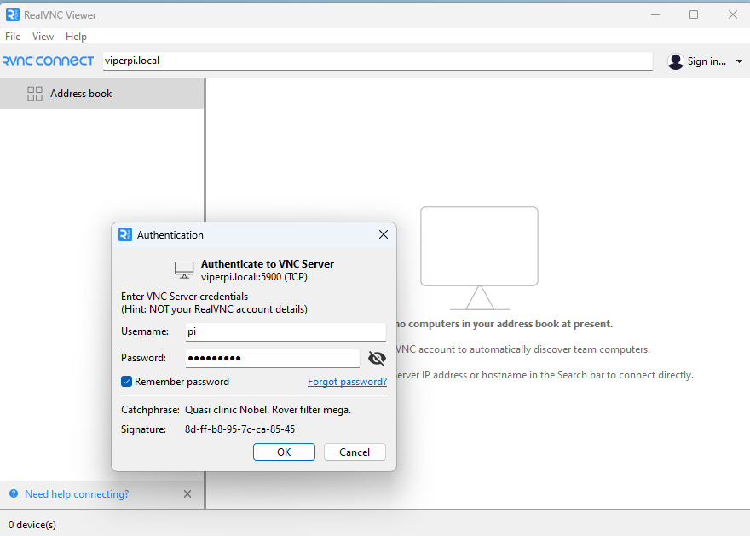
Establish a VNC session with Raspberry PI
Open the Real VNC viewer and enter the Raspberry Pi host name in the connect box.
recall the host have given should be the team's name followed by the keyword word “pi”.
For example, for Team “Viper”, the raspberry pi host name should be “viperpi.local”
Enter the hostname for your team’s pi in the Real VNC viewer connect box as shown and press
Supply the username “pi”, and the password your team specified.

Slide 23
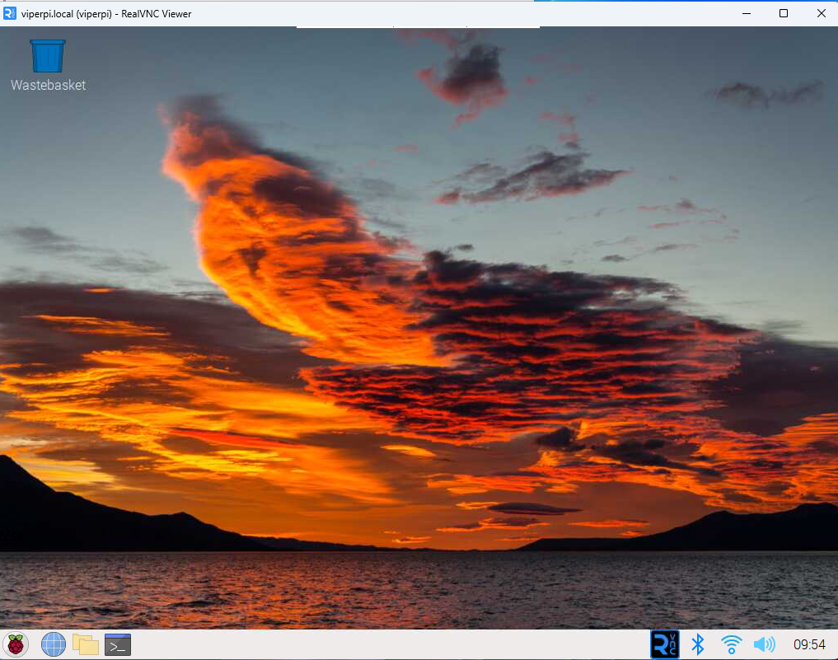
Established VNC session: a remote desktop experience, without the need for physical monitor and keyboard/mouse peripherals

Slide 24
MQTT Protocol is used to enable communication between the web (user) interface and the Raspberry PI
https://randomnerdtutorials.com/how-to-install-mosquitto-broker-on-raspberry-pi/

Slide 25
Install Mosquitto MQTT Broker on Raspberry PI
SSH to the Raspberry Pi:
Open a command terminal
Enter command: ssh pi@{teamname}pi.local - replace {teamname} with corresponding team name: example Team: “Viper” → ssh pi@viperpi.local
From the ssh session, enter command:
sudo apt install -y mosquitto mosquitto-clients
To make Mosquitto auto start when the Raspberry Pi boots, you need to run the following command (this means that the Mosquitto broker will automatically start when the Raspberry Pi starts):
sudo systemctl enable mosquitto.service
Test the installation by running the following command:
mosquitto -v
Source: https://randomnerdtutorials.com/how-to-install-mosquitto-broker-on-raspberry-pi/

Slide 26
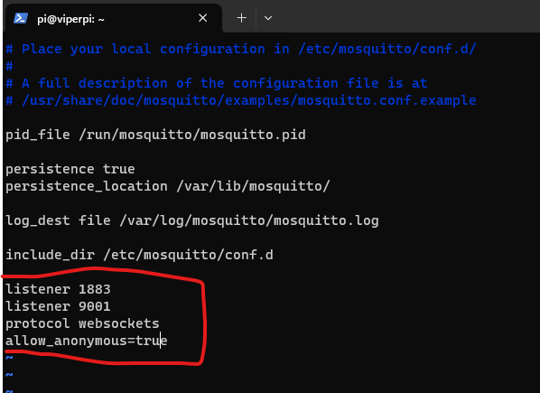
MQTT Broker configuration
Configure the MQTT Broker to use Websockets
https://randomnerdtutorials.com/how-to-install-mosquitto-broker-on-raspberry-pi/
http://www.steves-internet-guide.com/mqtt-websockets/
Use nano or vi to open: sudo nano /etc/mosquitto/mosquitto.conf
sudo systemctl restart mosquitto

Slide 27
Interlude: Short Linux Primer
Wait! Isn’t this camp about Raspberry Pi? Why are we pausing to talk about Linux?
Ans: Linux is an operating system that runs almost everywhere! In almost all IT technical careers, you will be required to know and use Linux proficiently.
Linux runs in more environments than you may realize:
Big enterprise datacenters, Cloud service backends, your Android phone, smart TVs, cameras, wearables (smart watches), etc.
And yes… it is the default OS that runs on your Raspberry PI.
Called Raspberry PI OS (based on the Debian GNU/Linux distribution )
https://en.wikipedia.org/wiki/Raspberry_Pi_OS
Reasonable (Funny) Video Intro to Linux
https://www.youtube.com/watch?v=zA3vmx0GaO8

Slide 28
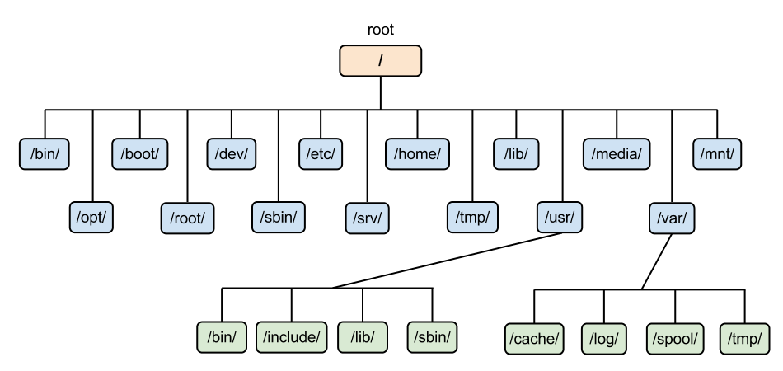
Linux Command Line
Shell - CLI - primer user interface to operating. Its essentially a program interprets user commands, and run other programs
Understanding the Filesystems
Files and folders (called directories), and are organized hierarchically (in a tree structure)
Basic Linux Commands (video)
https://www.youtube.com/watch?v=bb_ApuH15YE
Further study reference: “The Linux Command line” ebook
https://linuxcommand.org/tlcl.php
ls – list contents of folder
~ refers to home folder
cd – change to new directory (folder)

Slide 29
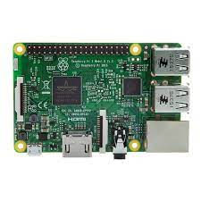
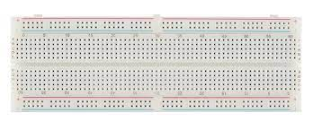
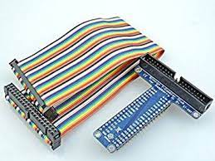
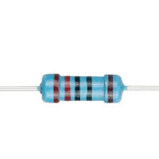
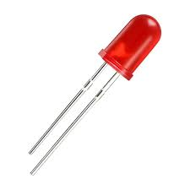
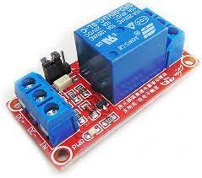
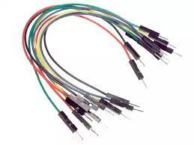
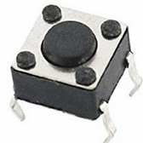
Module 2: Prototyping the IoT “Smart bulb” device
The “smart bulb” IoT device is implemented as a simple circuit, consisting of electronic components:
Fritzing is an open-source hardware initiative that makes electronics accessible as a creative material for anyone.
https://fritzing.org/
List of components:
1 x Raspberry Pi 3B
1 x full size bread board
1 x 40-pin ribbon cable
1 x T-cobber GPIO extender
2 x 220 Ohm resistor
2 X 5mm LED
1 X 5v 1 channel relay
Jumper wires
Switch button

Slide 30
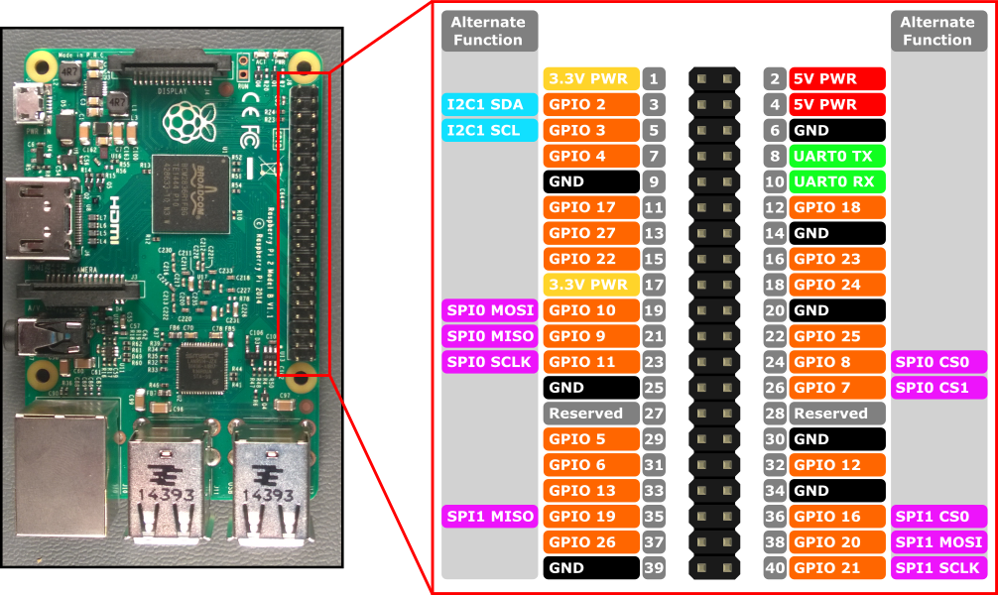
40-pin GPIO (general purpose input/output) Header
Allows the software (code) to touch/control the outside world…
Supports digital communication with external devices (the outside world) using serial bus protocols including: UART, SPI, i2c, and USB
Does NOT support analog inputs
We can fix that easily, by connecting an analog-to-digital converter (ADC) to Pi using serial communication
Serial comm Primer: https://www.youtube.com/watch?v=LEz5UCN3aHA

Slide 31
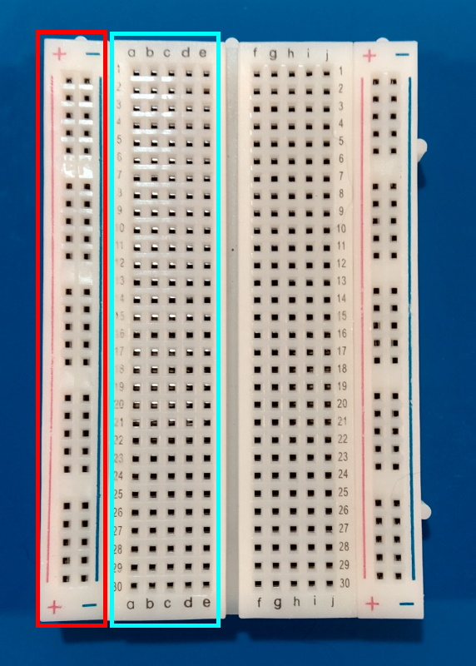
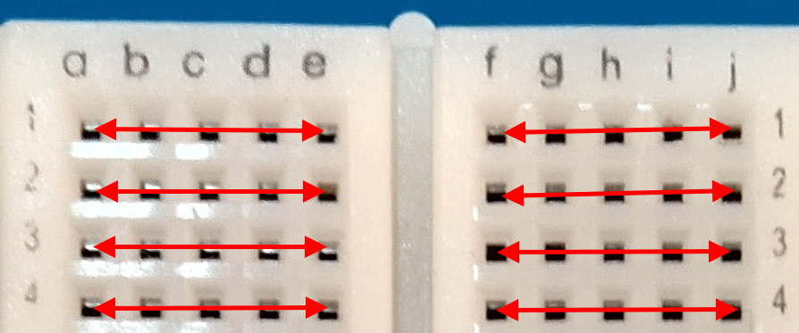
Breadboard
The breadboard is organized in rows and columns called socket strips (shown in cyan)
Socket strips are connected vertically
The bus strips on the edges (shown in red) are using connecting a power source (3.3v and 5v for the Pi)
Edge strips connect horizontally over the length of the breadboard
Socket strips allow components to be connected without soldering or wires.
Source: https://learn.microsoft.com/en-us/training/modules/create-iot-device-dotnet/2-construct-iot-hardware
Any pin plugged into row 1, column ‘a’ would be connected to any pin plugged into row 1, columns ‘b-e’.
On the other side of the divider, row 1 columns f-j are similarly connected.

Slide 32
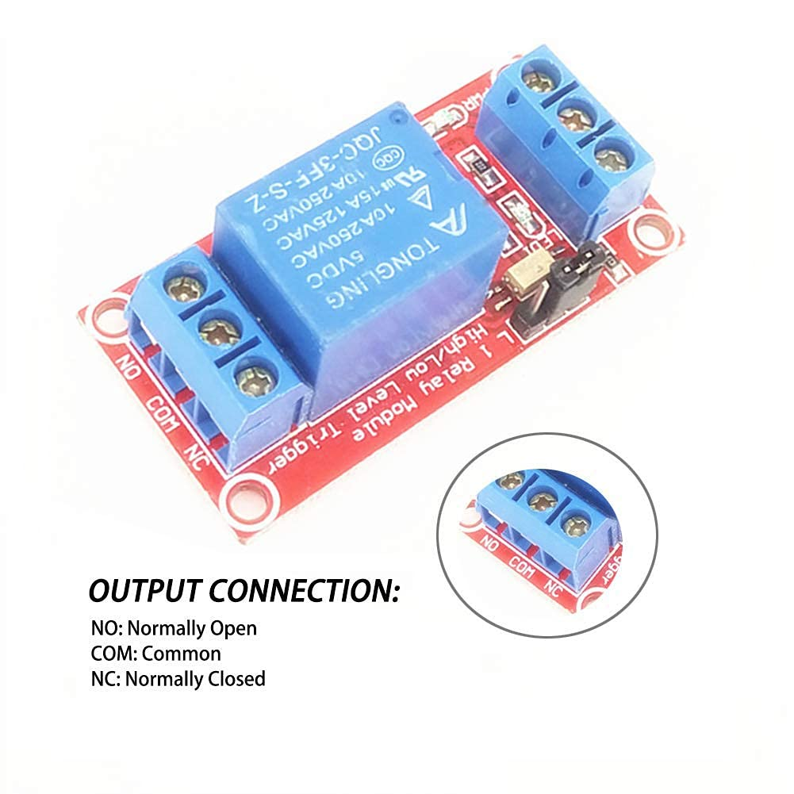
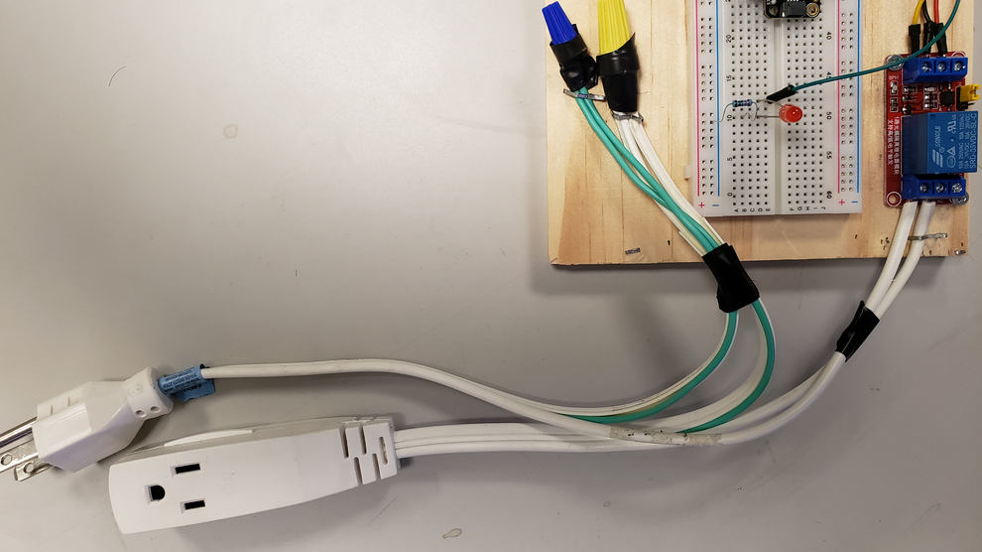
5v Relay Board Relay Module 1 Channel
is an electromagnetic switch used to programmatically activate/deactivate external devices (i.e., a desk lamp or fan).
Use a small current to control separate (often larger) current.
When a small current is passed through the low-voltage (5v DC) input on the relay it activates the switch (using a coil) and completes the separate high voltage (120v AC) circuit (i.e., a larger current).
This is one way we how can control external devices: fans, desk lamps

Slide 33
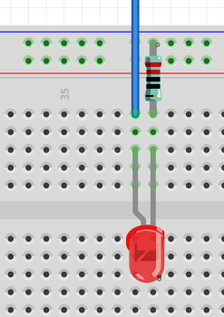
Resistor
Use of 220 Ohm resistor to limit the current through the LED and to prevent excess current that can burn out the LED
A resistor is a passive two-terminal electrical component that implements electrical resistance as a circuit element. In electronic circuits, resistors are used to reduce current flow, adjust signal levels, to divide voltages – [1]
[1] - https://en.wikipedia.org/wiki/Resistor

Slide 34
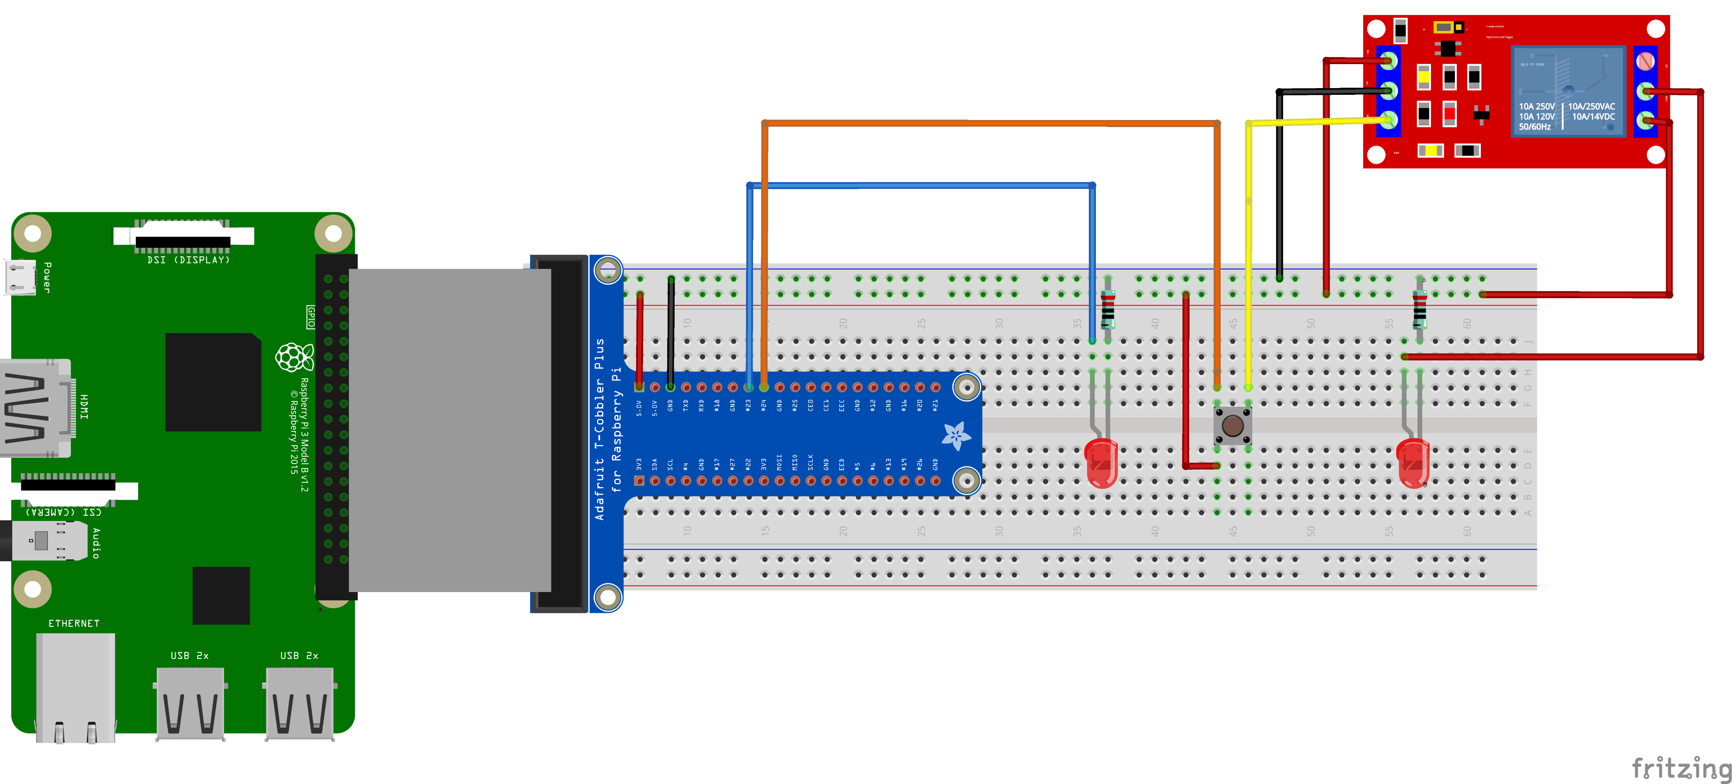
“Smart” bulb device (Fritzing circuit design concept)

Slide 35
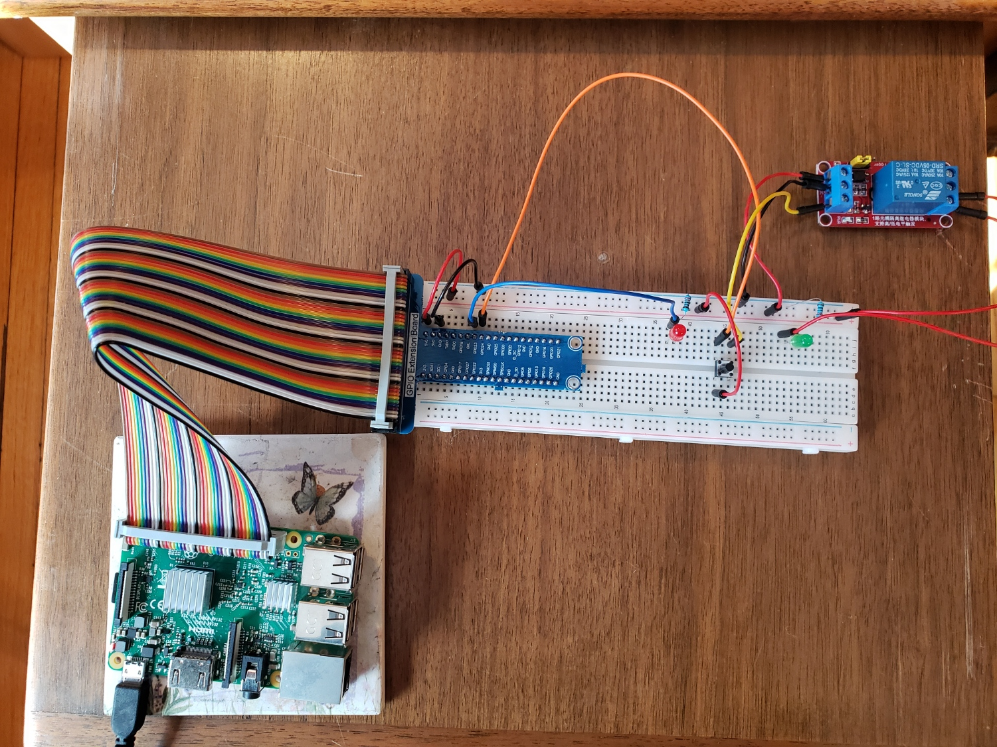
Completed “Smart” bulb device (hardware prototype)

Slide 36
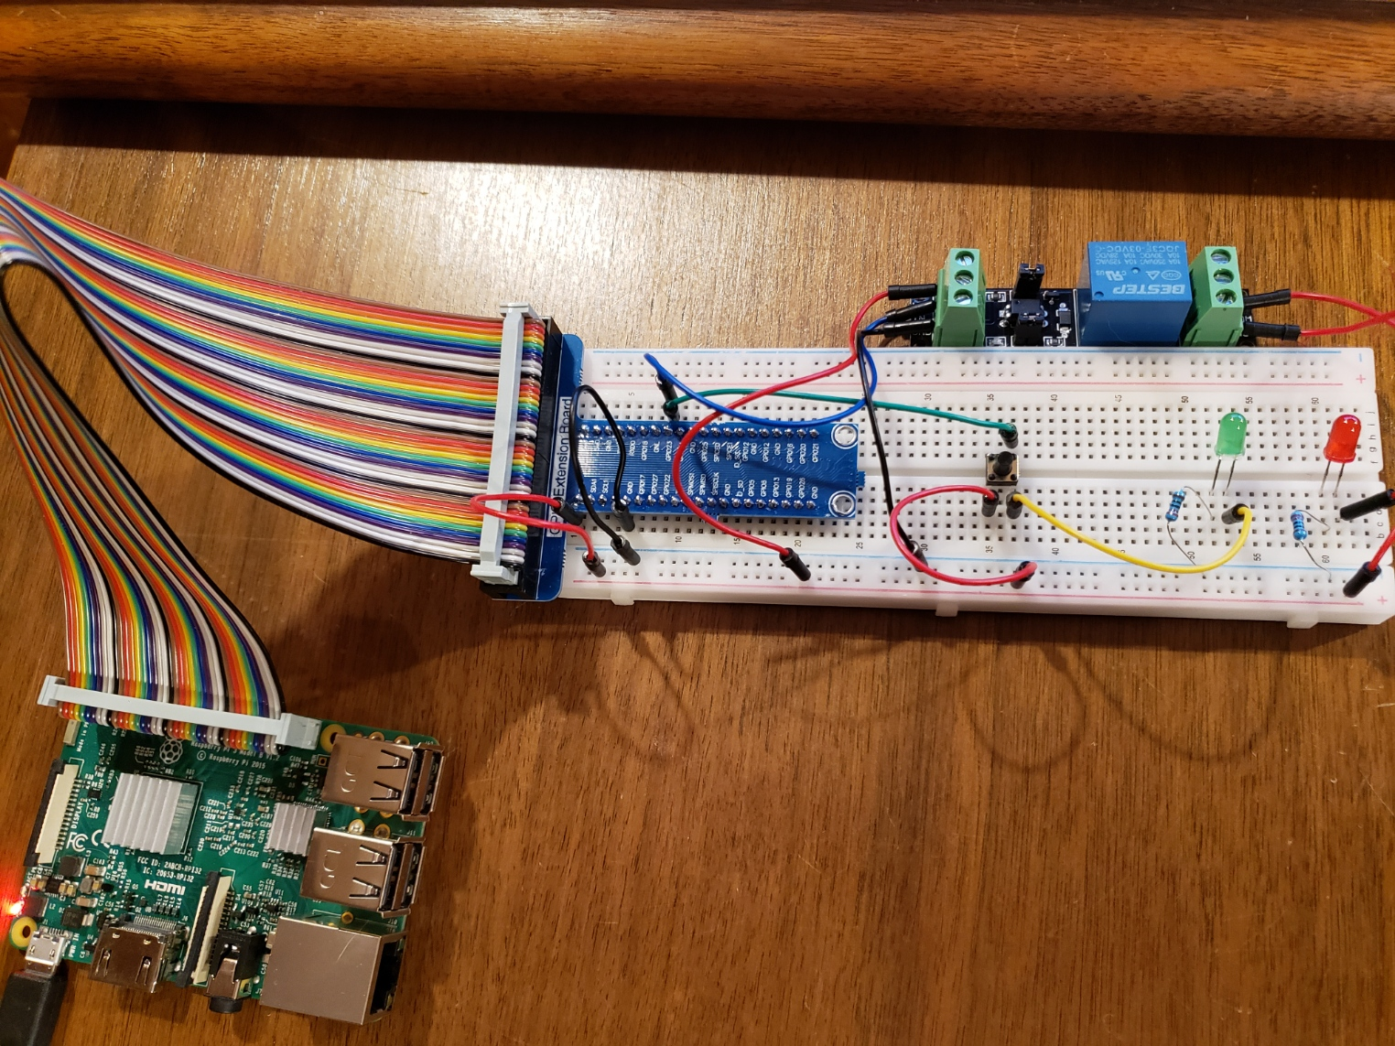
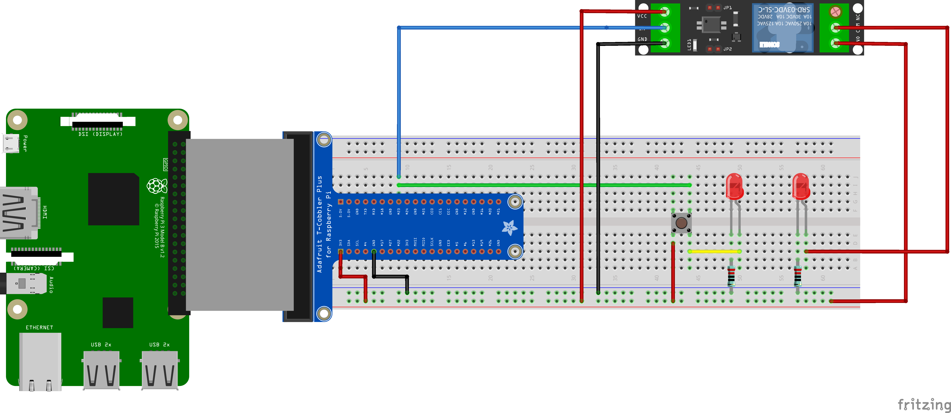
“Smart” bulb device (concept versus prototype)
versus

Slide 37
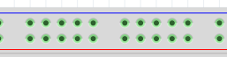
Constructing the device (electronic circuit):
Power off and disconnect the Raspberry Pi power source
Connect a “Red” jumper wire to the 5v pin of the T-Cobber and the positive (+) terminal strip of the breadboard (same side as the 5v pin). This provides 5v power to entire edge terminal socket strip designated by the red line
Connect a “Black” jumper wire to a “GND” pin on 5v side of the T-Cobbler, and the negative (-) terminal strip on the breadboard (same side 5v pin). This provides a ground (-) to the entire edge terminal socket strip designated by the blue line
Push an LED into the breadboard (as shown). Note: the bend in the LED terminal indicates the longer (+) LED anode. Connect a 220-ohm resistor between LED cathode (shorter negative - ) pin and the negative (-) terminal strip on the breadboard
Connect a “Blue” jumper wire to the GPIO pin 23 from the T-cobbler, and the LED anode: (longer positive +) pin
Push a switch button onto the bread board (as shown). Connect an “Orange” wire to GPIO 24 from the T-cobbler to the input side of the button
Connect “Red” wire from the positive (+) 5v terminal strip of the breadboard to the input side of the switch button
Connect a “Red” jumper wire from 5v positive (+) terminal strip of the breadboard to DC+ terminal on of the relay
Connect a “Black” jumper wire from negative (+) terminal strip of the breadboard to DC- terminal on of the relay
Connect a “Yellow” jumper wire to the output side of the switch button to the IN1 terminal of the relay.
Push an LED into the breadboard (as shown). Note: the bend in the LED terminal indicates the longer (+) LED anode. Connect a 220-ohm resistor between LED cathode (shorter negative - ) pin and the negative (-) terminal strip on the breadboard
Connect a “Red” wire to the NO (Normally open) terminal of the relay to the 5v (positive +) terminal strip of the breadboard
Connect “Red” wire the COM (Common) terminal of the relay to the (positive +) terminal of the LED Note: the bend
7.
2.
*5.
8.
4.
1.
*3.
11.
12.
*10.
*3.
*6.
*5.
9.
Connect and power on Raspberry Pi: press the button to activate the bulb
* - indicates multiple steps

Slide 38
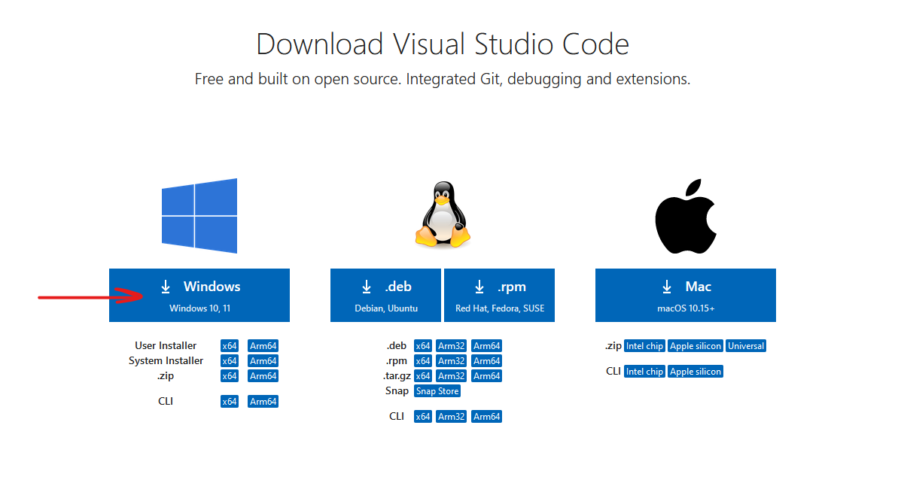
Module 3: Develop the software to control the “smart” bulb
Prerequisites:
Download and install Visual studio code for Windows:
https://code.visualstudio.com/download

Slide 39
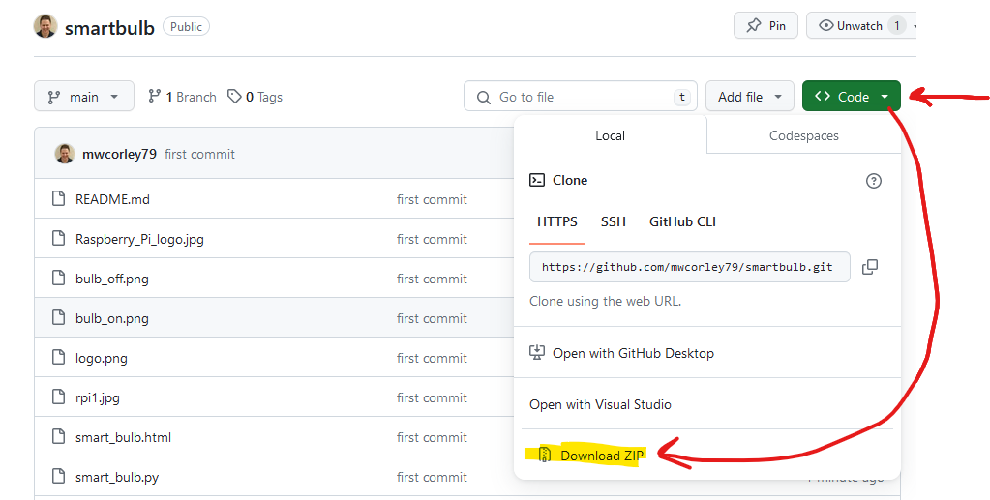
Download the smart bulb source code from GitHub: https://github.com/mwcorley79/smartbulb
Choose “Code”→”Download Zip”, and save the zip to the Desktop on the laptop
Extract the zip to the desktop

Slide 41
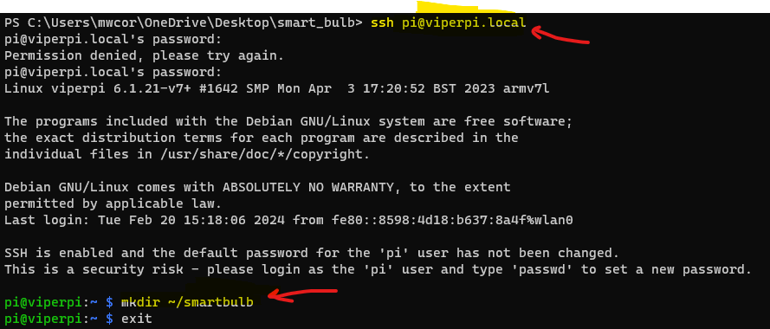
Secure copy: scp
Use SCP to move the python script (representing the backend) to the Raspberry: smartbulb.py
Interfaces through the GPIO header, to control the desk lamp
Open terminal (in Windows or in VSCode)
start an SSH session with Raspberry Pi:
Enter command: ssh pi@{teamname}pi.local - replace {teamname} with corresponding team name: example Team: “Viper” → ssh pi@viperpi.local
Create a new folder to for the python script:
Issue the command:
mkdir ~/smartbulb

Slide 42
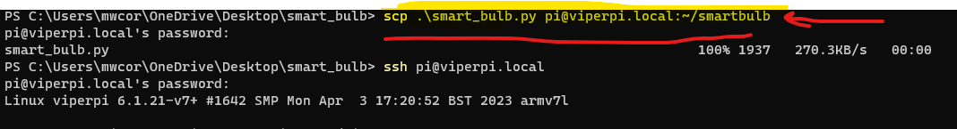
Secure copy: scp
Use SCP to move the python script (representing the backend) to the Raspberry: smartbulb.py
Interfaces through the GPIO header, to control the desk lamp
Open terminal (in Windows or in VSCode)
start an SSH session with Raspberry Pi:
Enter command: ssh pi@{teamname}pi.local - replace {teamname} with corresponding team name: example Team: “Viper” → ssh pi@viperpi.local
Create a new folder to for the python script:
Issue the command:
mkdir ~/smartbulb
Open another new terminal
Navigate “smartbulb” project folder and issue the following command:
scp .\smart_bulb.py username@ip-address:~/smart_bulb

Slide 43
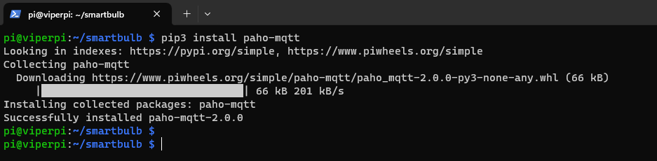
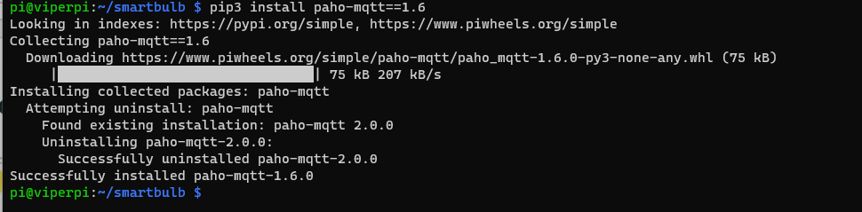
Install the python MQTT client on Raspberry Pi
pip3 install paho-mqtt=1.6

